Slide 1
4th grade field trips
2015-16

Slide 2
The places we’ll go!
free for all students
Hoover Dam
Red Rock Conservation Area
Lake Mead Recreational Area
Philharmonic
self-funded
So. NV ghost towns
Ash Meadows wildlife refuge & Death Valley
Carson City & Virginia City

Slide 3
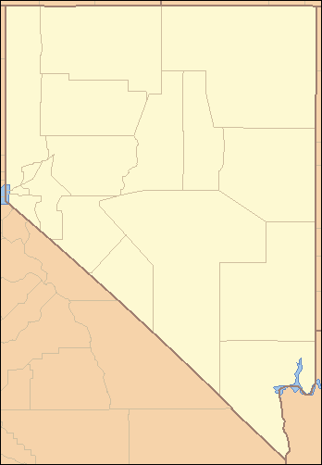
Carson City Virginia City
ghost towns
Death Valley
Lake Mead
Red Rock
Hoover Dam

Slide 4
all students included
tentative times of the year
Hoover Dam—end of April
Lake Mead Recreational Area*—after Spring Break
Red Rock Conservation Area*—Fall 2015
*thanks to the Every Kid in a Park program from the National Park Service

Slide 5
self-funded
Southern Nevada
$60 per person
March 31 – April 1*
Day 1: Ghost towns
Day 2: Ash Meadows & Death Valley
Northern Nevada
$320/student $340/chaperones
May 24 – 25*
Day 1: Carson City
Day 2: Virginia City
*tentative prices & dates

Slide 6
Southern Nevada
Ghost towns
Goldfield, Gold Point, Beatty, and Rhyolite
Outdoors areas
Ash Meadows National Wildlife Refuge
Death Valley, California

Slide 7
Tentative Itinerary
Day 1
7 a.m. leave Nate Mack
10 a.m. tour Goldfield
1:30 p.m. tour Gold Point
3 p.m. tour Rhyolite
5:30 p.m. return to Nate Mack
Day 2
7 a.m. leave Nate Mack
9:30 a.m. tour Ash Meadows National Wildlife Refuge
1:30 p.m. tour Death Valley National Park
5:30 p.m. return to Nate Mack
anticipated cost: $60 per person

Slide 8
Northern Nevada
Carson City
Legislature, Supreme Court, Capitol offices, Nevada State Museum, Stewart Indian School
Virginia City
Fourth Ward School, Chollar Mine, Goldstamp Mill, V & T Railroad

Slide 9
Tentative Itinerary
Day 1—Carson City:
5:30 a.m. meet at McCarran airport
9 a.m. tour Legislature, Supreme Court, Capitol, state museum
2 p.m. tour Stewart Indian School
5:30 p.m . dinner and overnight in Reno
Day 2—Virginia City:
9 a.m. tour 4th Ward School, Goldstamp Mill, Chollar Mine
11:30 a.m. V & T Railroad lunch tour to Gold Hill
2 p.m. walking tour of Virginia City
6 p.m. dinner in Reno
9 p.m. return to McCarran airport estimated cost: $320/student
$340/chaperone

Slide 10
Where do I sign up?
Fill out the forms for free trips
Chaperone information will be sent closer to the trip date
Make deposits to save NoNV spot by Oct. 29
Fundraiser—40% goes to NoNV, then SoNV
Cookie Dough sales in January—40%
Payment for SoNV starts in February

